Slide 1
Linear Arrival Rate Approximation
Rushil Chugh
Nikhil Khatu

Slide 2
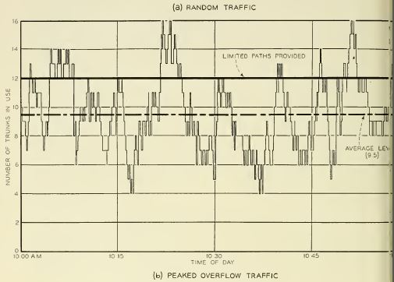
Random Traffic
*From Wilkinson

Slide 3
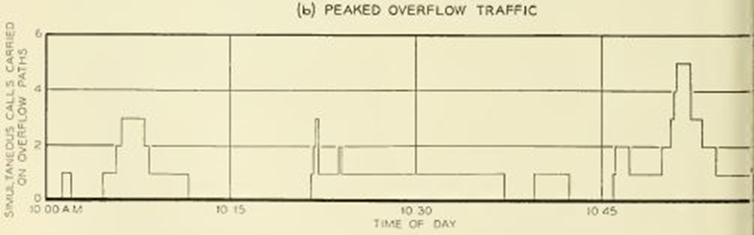
Overflow Traffic
*From Wilkinson

Slide 4
Question
“What would be the physical description of a cause system with a variance smaller or larger than the Poisson?” - Wilkinson

Slide 5
Physical Description
“If the variance is smaller, there must be forces at work which retard the call arrival rate as the number of calls recently offered exceeds a normal, or average, figure, and which increase the arrival rate when the number recently arrived falls below the normal level. Conversely, the variance will exceed the Poisson’s should the tendencies of the forces be reversed.” -Wilkinson

Slide 6

Linear Arrival Rate System
Arbitrary function that modifies call origination rate.
0 < Beta < 1
# of calls present
‘mu’ is set to 1
Base Arrival Rate
alpha >= 0

Slide 7

Birth/Death Process

Slide 8
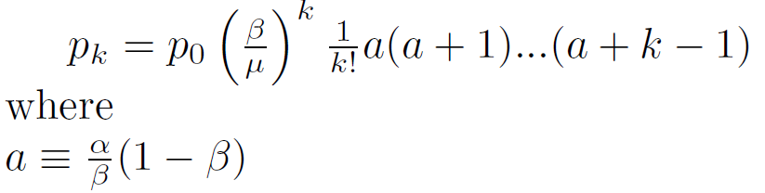

Binomial Coefficient
Coefficient ‘x’ is

Slide 9
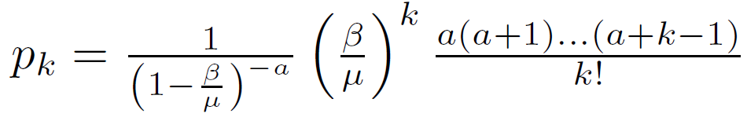
Probability Distribution of LA System

Slide 10



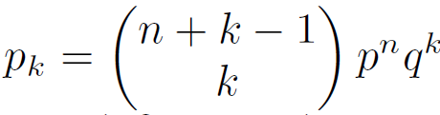


Negative Binomial Distribution (Pascal)

Slide 11


1st and 2nd Moments
*Beta is always between 0 and 1, Z values will always be greater than 1. This translates to a peaked process. (As opposed to a smooth process)

Slide 12
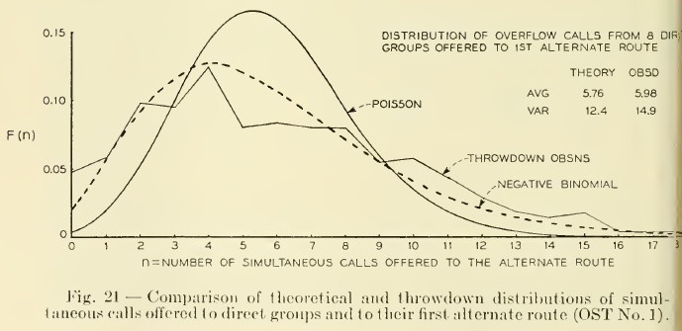
Poisson vs Negative Binomial

Slide 13

Plotting the Distribution
 | Beta = 0.5 | Beta = 0.75 | Beta = 0.9
a = 10 | Alpha = 10 | Alpha = 30 | Alpha = 90
a = 20 | Alpha = 20 | Alpha = 60 | Alpha = 180
a = 30 | Alpha = 30 | Alpha = 90 | Alpha = 270

Slide 14
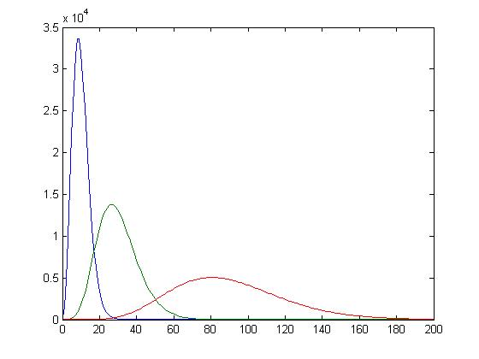
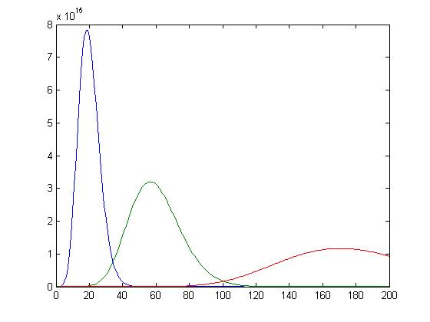
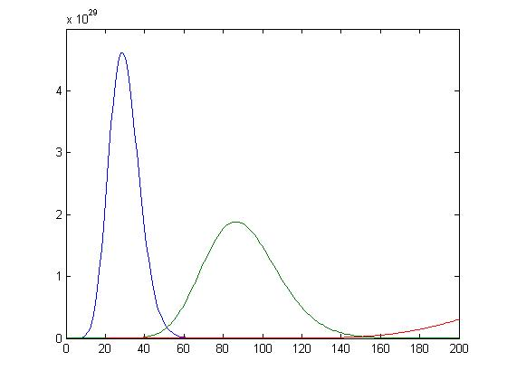


Plots by value of a
a = 10
a = 20
a = 30

Slide 15
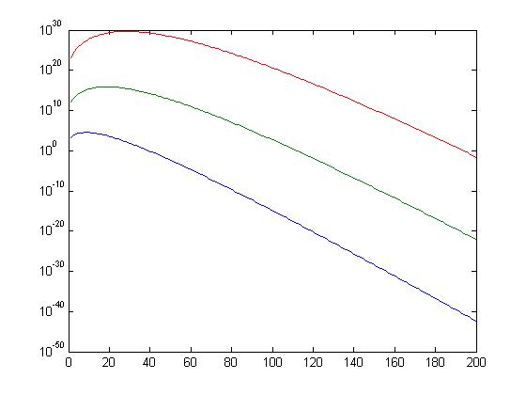
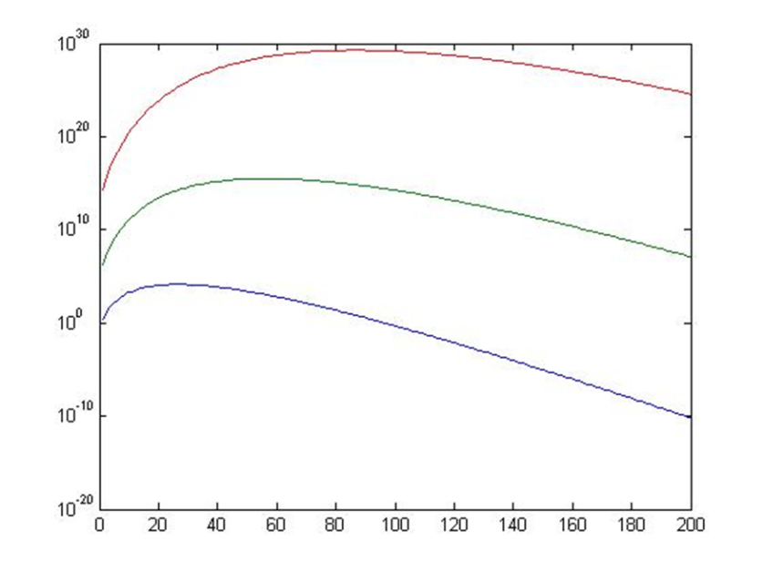
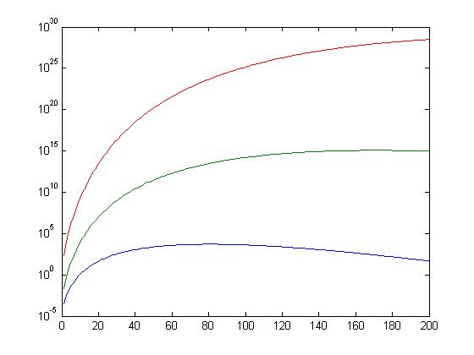
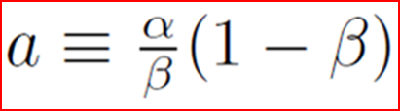
Plots by Beta value
Beta = 0.5
Beta = 0.75
Red: alpha = 30
Green: alpha = 20
Blue: alpha = 10
Beta = 0.90
Red: alpha = 90
Green: alpha = 60
Blue: alpha = 30
Red: alpha = 270
Green: alpha = 180
Blue: alpha = 90

Slide 16
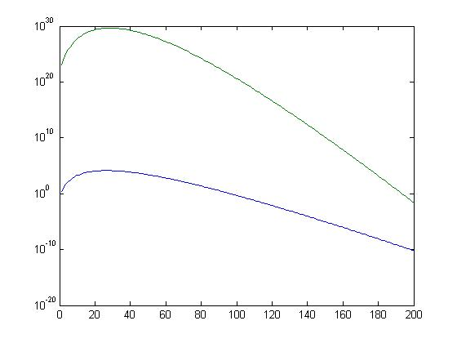
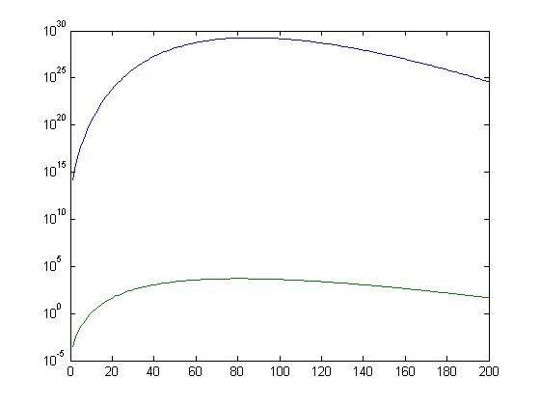
Plots with same alpha
alpha = 30
Blue: a = 10, beta = 0.75
Green: a = 30, beta = 0.50
alpha = 90
Blue: a = 30, beta = 0.75
Green: a = 10, beta = 0.90

Slide 17
Simulation
 | Beta= 0.25 | Beta= 0.50 | Beta= 0.75 | Beta = 0.90 | Beta = 0.99
alpha = 3 | Mean = 3 | Mean = 3.5 | Mean = 4.5 | Mean = 7.5 | Mean = 50
alpha = 10 | Mean = 11 | Mean = 11 | Mean = 12 | Mean = 14 | Mean = 50
alpha = 50 | Mean = 100 | Mean = 100 | Mean = 100 | Mean = 100 | Mean = 100

Slide 18
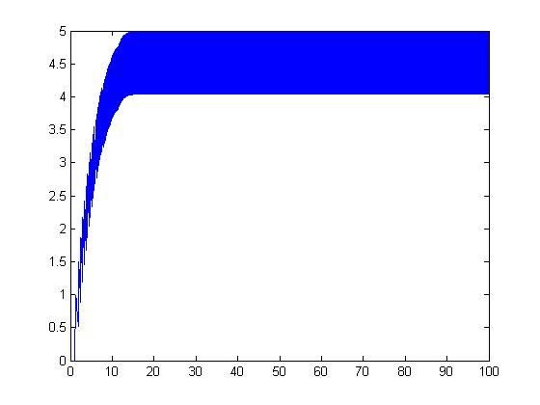
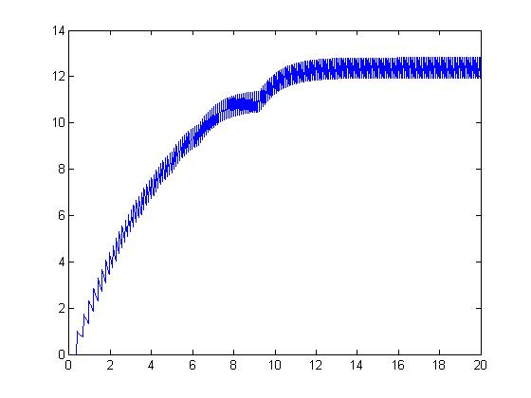
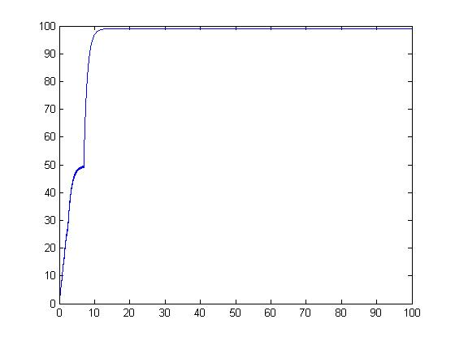

Simulation Plots
alpha = 3
beta = 0.75
alpha = 10
beta = 0.75
alpha = 50
beta = 0.75

Slide 19
References
Andre Girard- Routing and dimensioning in circuit-switched networks
Wilkinson, R.I., “Theories for toll traffic engineering in the USA,” Bell System Technical Journal, vol. 35, pp 421-514, 1956.
CSC 777- Professor Rudra Dutta

Slide 20
Test Your Comprehension
Why use Linear Arrival Rates?
What kind of Distribution does a Linear Arrival Rate system resemble?
What is the purpose of using Beta when calculating Arrival rate?

